Slide 1


In the name of Allah, the Beneficent, the Merciful
CSE312
Lecture 1: Basics of Software Quality

Slide 2


“Quality is never an accident, It is always the result of intelligent effort”
-John Ruskin

Slide 3



Slide 4

Disney’s Lion King, 1994 –1995
Patriot Missile Defense System, 1991
The Y2K (Year 2000) Bug, 1974
Intel Pentium Floating-Point Division Bug, 1994
  (4195835 / 3145727) * 3145727 – 4195835

Slide 5



Computer programs and associated documentation
Software products may be developed for a particular customer or may be developed for a general market

Slide 6

Computer programs, procedures, and associated data and documentation pertaining to the operation of a computer system
Software errors are introduced when there is a failure to completely and accurately translate one representation to another, or to fully match the solution to the problem
Notes:
Computer Program: a series of instructions/statements in a form acceptable to computer and designed to cause the computer to execute an operation(s).
Computer data: a representation of facts, concepts, or instructions in a structured form suitable for acceptance, interpretation, or processing by computer.
Computer Program Documentation: technical data, including program listings & printouts in human readable form which document the requirement, design, implementation, and other details of the computer program. Also instructions for using and maintaining the computer program.

Slide 7

An inherent or distinguish characteristic, a personal trait, degree or grade of excellence
  The American Heritage Dictionary of the English Language
Quality is conformance to requirements and prevention of defects
The degree to which a system, component, or process meets specified requirements
Notes:
Trait → Attribute, Characteristic

Slide 8

Everyone claims to manufacture / develop / sell / market “good” quality products / services
You will never come across a person or company selling products or services as low or poor quality products, even when they are

Slide 9

Quality as it relates to all aspects of software (requirements / design / code / tests / documents / training)
Difficult to define

Slide 10

“For a software application to achieve high quality levels, it is necessary to begin upstream and ensure that intermediate deliverables and work products are also of high quality levels. This means that the entire process of software development must itself be focused on quality”
  Capers Jones

Slide 11

Perceived in different domains differently
Five major views according to Jeff Tian
User’s | fitness for purpose, meeting user’s needs
Manufacturing | conformance to specification, standards
Product | inherent characteristics of the product
Value based | the amount a customer is willing to pay
Transcendental | that can be recognized but not defined
Notes:
Quality Perspective from the book Wiley-InterScience - Software Quality Engineering - Testing, Quality Assurance and Quantifiable Improvement
Transcendental → Surpassing all others; Superior; Beyond common thought or experience; mystical or supernatural.
Elusive → vague, intangible, indefinable

Slide 12
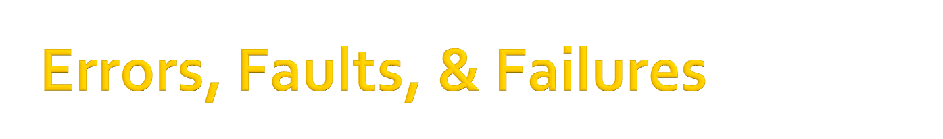
A person makes an Error
That creates a fault in software
That can cause a failure in operation
Error : A human action that produces an incorrect result. This is also sometimes referred to as Mistake.
Fault: A manifestation of an error in software, also known as Defect or Bug.
Failure: A deviation of the software from its expected delivery or service.

Slide 13
Errors may cause faults to be injected into the software, and faults may cause failures when the software is executed
A single error may cause many faults, such as in the case that a wrong algorithm is applied in multiple modules and causes multiple faults, and a single fault may cause many failures in repeated executions

Slide 14

1 #include<stdio.h>
2
3 int main ()
4 {
5 int value1, value2, ans;
6
7 value1 = 5;
8 value2 = 3;
9
10 ans = value1 - value2;
11
12 printf("The addition of 5 + 3 = %d.", ans);
13
14 return 0;
15 }

Slide 15
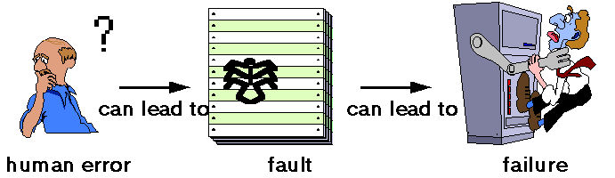

Slide 16
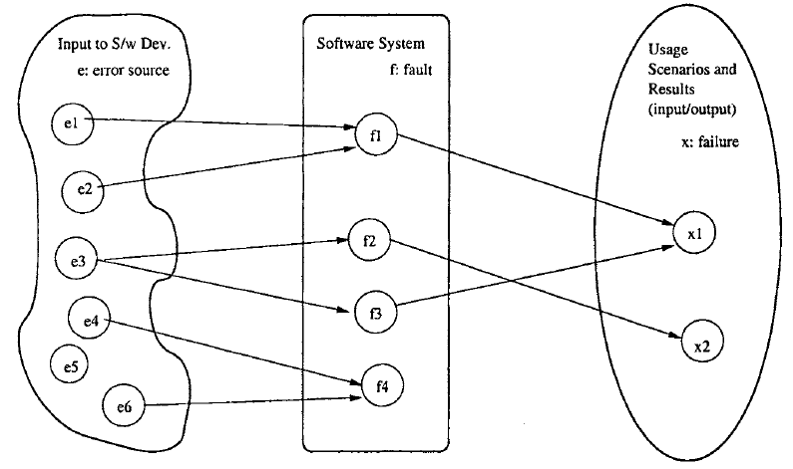


Slide 17
Faults which do not cause a failure under the given scenarios are typically called dormant or latent faults, which may still cause problems under a different set of scenarios or circumstances

Slide 18
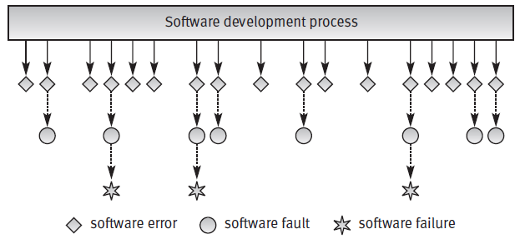
Software errors are introduced when there is a failure to completely and accurately translate one representation to another, or to fully match the solution to the problem
Notes:
Computer Program: a series of instructions/statements in a form acceptable to computer and designed to cause the computer to execute an operation(s).
Computer data: a representation of facts, concepts, or instructions in a structured form suitable for acceptance, interpretation, or processing by computer.
Computer Program Documentation: technical data, including program listings & printouts in human readable form which document the requirement, design, implementation, and other details of the computer program. Also instructions for using and maintaining the computer program.

Slide 19

Faulty requirements definition
Client–developer communication failures
Deliberate deviations from software requirements
Logical design errors
Coding errors
Non-compliance with documentation and coding instructions
Shortcomings of the testing process
Procedure errors
Documentation errors

Slide 20

Quality is not just meeting requirements - it has many dimensions
Software Quality Attributes
  External (rely on execution)
  Internal (do not rely on s/w execution)
Notes:
Internal Metrics: Internal metrics are those which do not rely on software execution (static measures)
External Metrics: External metrics are applicable to running software.
Robustness is the quality of being able to withstand stresses, pressures, or changes in procedure or circumstance. A system, organism or design may be said to be "robust" if it is capable of coping well with variations (sometimes unpredictable variations) in its operating environment with minimal damage, alteration or loss of functionality.

Slide 21

External Attributes (Rely on Execution) | Internal Attributes (Do Not Rely on Execution)
Correctness | Maintainability
Reliability | Flexibility
Usability | Portability
Efficiency | Reusability
Integrity | Readability
Adaptability | Testability
Robustness | Understandability

Slide 22

Maintainability - Can I fix it?
Flexibility - Can I change it?
Testability - Can I test it?
Portability - Will I be able to use it on another machine?
Reusability - Will I be able to reuse some of the software?
Interoperability - Will I be able to interface it with another machine?
Product
Revision
Product
Transition
Product
Operations
Correctness - Does it do what I want?
Reliability - Does it do it accurately all the time?
Efficiency - Will it run on my machine as well as it can?
Integrity - Is it secure?
Usability - Can I easily use it?

Slide 23

Software Quality
  Software quality measures how well software is designed (quality of design), and how well the software conforms to that design (quality of conformance)
Quality Software
  Software that exhibit all the functional capabilities and non-functional attributes that ensure that it can be put to all its intended uses with the least effort, inconvenience and resources
Notes:
Stifle → suffocate, Suppress

Slide 24

Summary

